Slide 1
Issues with buying a used car
Colby Lewis
Tony Nguyen
Josue Cerritos
Hoang Vo
Kent Nguyen

Slide 2
The problem we are trying to solve
We are trying to identify common issues people face while trying to buy a used car.
Rather the problem is: Long annoying paperwork, not knowing what car to buy, the buying process being too long and overwhelming, etc.

Slide 3
Market segment matrix
Industry | Mall and Grocery shoppers | Car Dealerships
End Users | Parents, college students, economy people with bulk shopping, families | Car Sellers, Car flippers, Car Selling Websites
Application | -basic shopping activities. -big transportation. -weather issues | - Product being sold -Offering services to help on the research
Benefits | -saving time -saving money -safety | -Attracting more customers -Increase Revenue
Partners | -grocery security -shop workers | -dealerships -Used Car Lots -Random Online Seller

Slide 4
Market segment matrix
Industry | Large Business | Services
End Users | -Employees -Delivery Drivers | -Employees (taxies, deliveries) -Families
Application | -Allowing for transportation of products -Commuting for meetings - Offer services at designated locations | -Allowing for transportation -Commuting -Offer services
Benefits | -reduce cost for transportation -increase productivity | -Earning -Family business/activities -Customer satisfaction
Partners | -Large Companies | -Communication system (phones, Uber, Lift,...)

Slide 5
Market segment matrix
Industry | School System | Agriculture
End Users | -Bus Drivers -Workers | -Farmers -wednesday sellers at UH
Application | -Transportation for students -Move equipment from school to school | -Transportation of agriculture products
Benefits | -Secure transportation for the students -ease of transport | -Flexible businesses -Community -variety of products
Partners | -School District -Bus services | -school district -small grocery stores/ marts

Slide 6
What we thought before the interviews
-People need to buy cars for basic shopping activities; during shopping, people relax to find their needed items at right prices. This segment is popular because the common earning cares about saving, budget, and essential daily activities which would be very exhausted without cars.
+customers: parents, independent students, single people of common salaries
+Benefits: time saving, energy saving, avoid hash weather, bulk shopping…
-Car dealers are where local people often come to find cars ( inspect the cars in person)-> places with many common customers.
+Customers: local people
+Car dealers offer benefits of geography and introduction of middle men, insurance, car services, but can charge same layers of price -> leading to issues.
*We believed that their would some sort of consistency in the answer that people gave out
*We believed people would be more annoyed by the paperwork process than there actually was.

Slide 7
What we did
Total people that we interviewed: 60
Locations:
-At grocery stores, food marts, malls: interview people who carefully check labels during shopping; people who waited for their orders; people who were cheerful-looking in home decoration section in Malls; shopping people who went around car utility section in Walmart.
-At car mechanic, car wash: approached customers who drove using old cars, while waiting for their cars to be fixed or washed.
-At Pharmacies and car parts shops: targeted people who were english speakers and that were young or had a family as they tend to be more willing to speak
-At a sport event: gather a group of people and have them answer the questions by sharing their experiences.

Slide 8
What we did(continued)
Obstacles:
-In grocery shopping and malls, people were not usually relaxing. They were busy and hurried. Sometimes, there was barrier of languages. Hence, we needed to locate people whom we could communicate: checking english labels, waiting for orders of food, ingredients, and drink, finding decorations, checking items in car section.
-People often ignored interviews by strangers. We wore red t-shirts of UH and introduced our identities to get people to help us.
-Those who were non-native english speakers tend to be more wary of anyone that attempted to ask them anysort of question, making it difficult to get their responses.

Slide 9
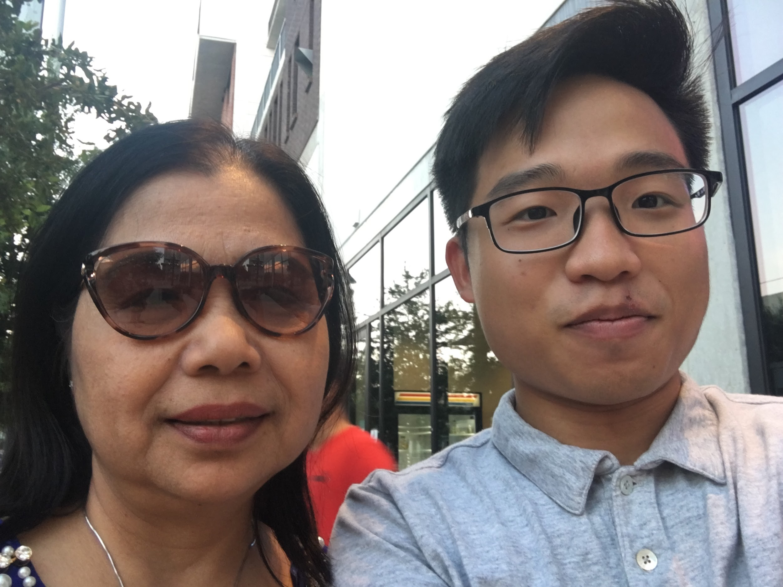
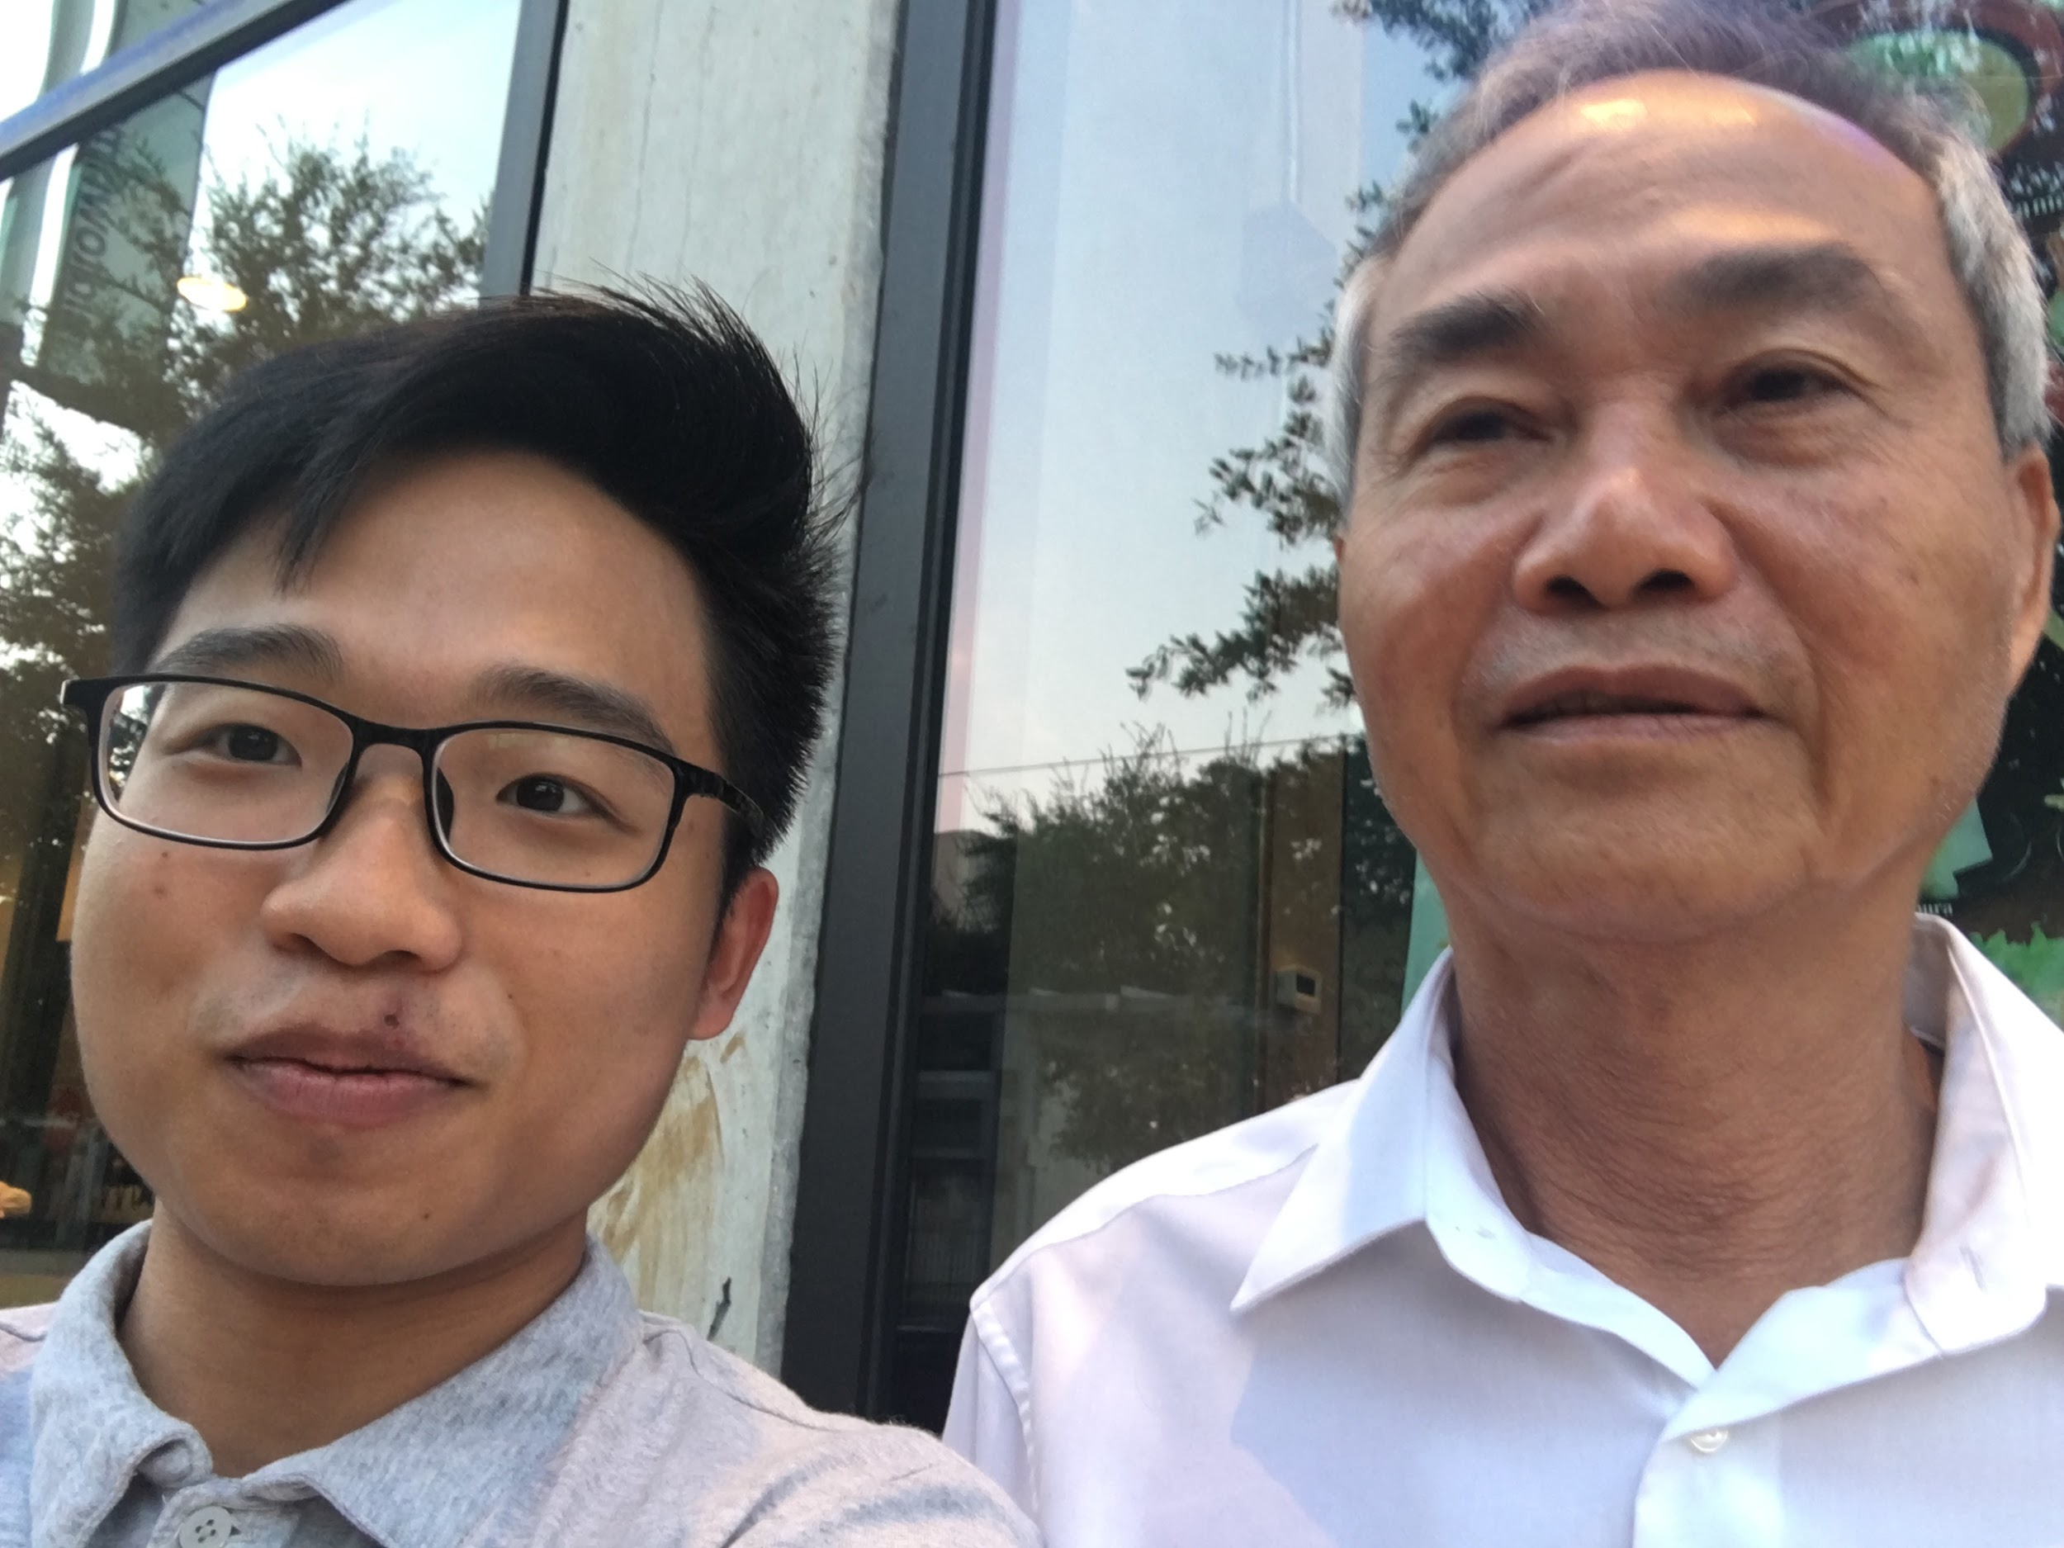
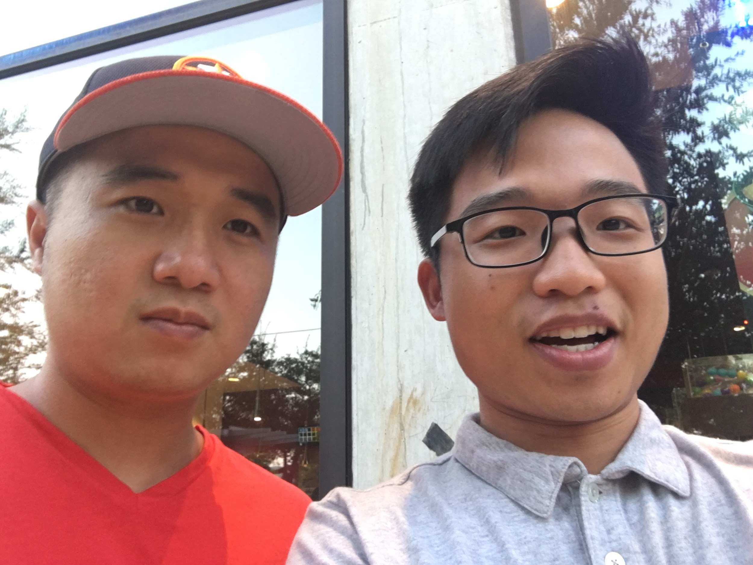
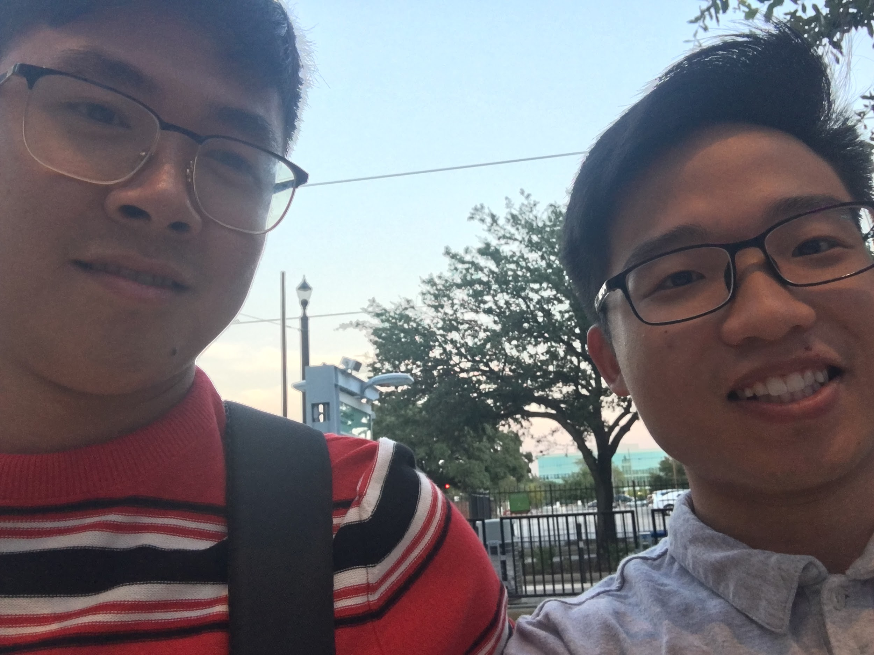
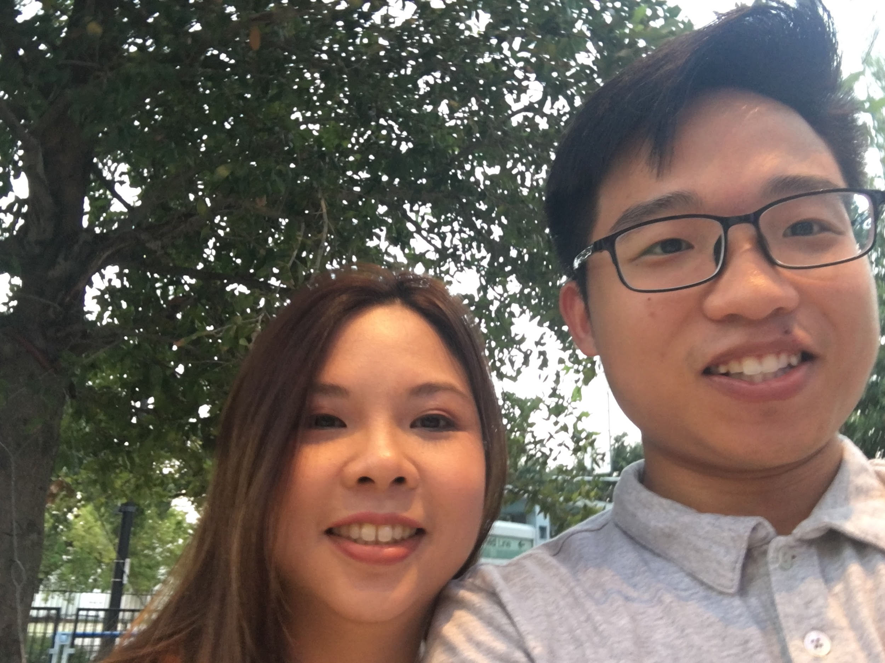
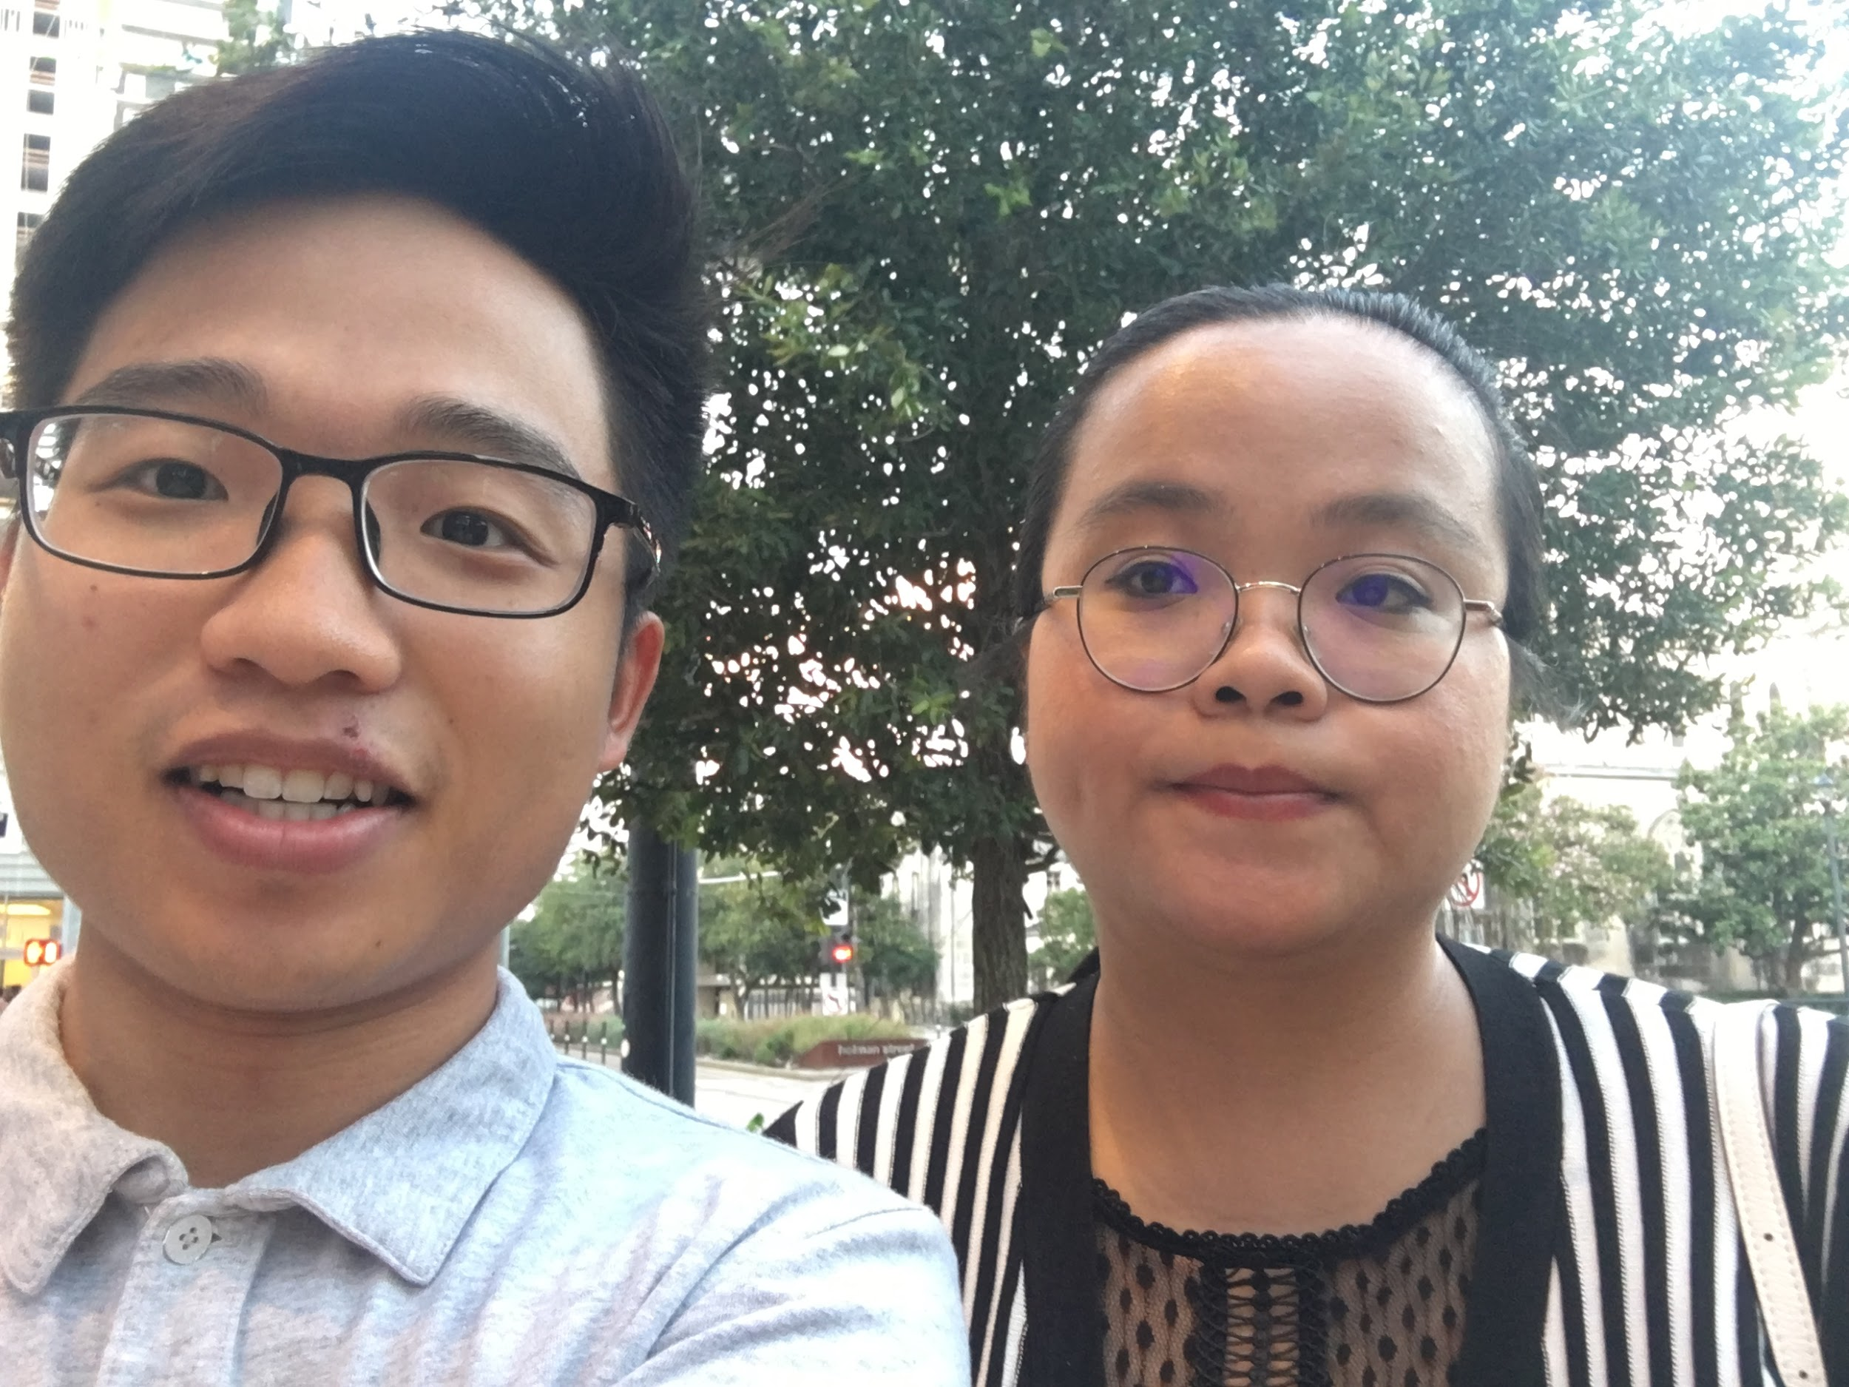
What we did(continued)
Pictures:

Slide 10
What we found
Majority of people preferred car dealers than a regular person.
People who often bought from a dealer often experienced no problems in the process of buying a used car.
Generally took a day or within a few hours for people to complete the transaction.
People usually did price negotiation for their limit in finance, especially if the cars are just for basic need, not for show. 7 out of 10 interviewed people tried to get the right car at lower prices. Special case of an international student bought his car with cash.
Some negotiations took up to days.
Few people experienced issues with the paper process and cosigning.

Slide 11
What we found(continued)
A case mentioned that buyers can depend on Car Mechanic to inspect quality of cars before buying.
Those who bought from a person experienced frequent car repairs needed shortly after purchase. (Tires, alternator, transmission, etc)
Many of those who are in their mid to late 20’s tend to Cosign with a partner or a parent
Immigrant families usually tell their kids to shop around for an affordable car online first before negotiating at the dealership.
People usually check the car’s report history and tend to stay away from cars which were involved in accidents.

Slide 12
What we plan to do next
Interview Mechanics (maybe)
Brainstorm some possible ways to reduce the difficulty of dealing with the paperwork for the process
Figure out a way to help people find a car that they love
Finding out convenient websites that help users find good prices and reliable local dealers
Plan out the schedule for the rest of this project and set deadlines

